Slide 1
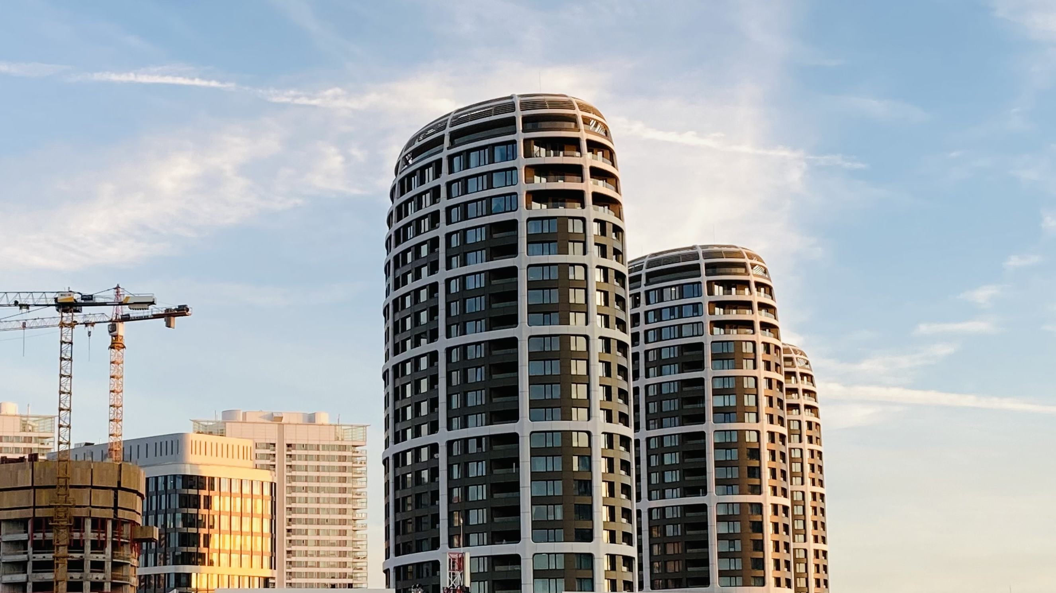
Title of the paper [Calibri 54 pt]
First Author, Second Author, Third Author [Calibri 24 pt]
First affiliation, Address, City, Country Second affiliation, Address, City, Country [Calibri 18 pt]
5th Central European Symposium on
Building Physics - Bratislava, Slovakia
Institution Logo

Slide 2
Headline [Calibri Bold 44 pt]
Calibri 28 pt
For full papers, the oral presentation is maximum 15 minutes in length
After the presentation, 5 minutes are reserved for questions
Consider approximately 1 minute per slide
The slides can be prepared as PowerPoint or PDF-presentations
We suggest the use of this document as a template if you use PowerPoint.
5th Central European Symposium on
Building Physics - Bratislava, Slovakia
[Title of the paper] [Presenter’s name]

Slide 3
Headline [Calibri Bold 44 pt]
Calibri 28 pt
Please write short sentences, and assist with illustrations
Practice the presentation so you don’t exceed the timing
The information given in this template is suggested. Presenters are encouraged, but not required to conform to these suggestions
See you soon in Bratislava!
5th Central European Symposium on
Building Physics - Bratislava, Slovakia
[Title of the paper] [Presenter’s name]

Slide 4
Thank you!
[Presenter’s name]
[Presenter’s email contact]
5th Central European Symposium on
Building Physics - Bratislava, Slovakia

